Slide 1
Waste Management System
-By Kunal Jaiswal
Jayesh Patil
Sumeet Janawlekar

Slide 2
Agenda
Problem Statement
Approach
Object Model
Functionalities/Use Cases
Application Overview

Slide 3
Problem Statement
254 Million ton of trash is produced in the US every year out of which 6.6 million ton of trash is produced by Boston. Out of the 254 million ton waste that is produced, only 35% of the waste is recycled. Our mission is to develop a system for collection, transportation, storage, recycling and monitoring of waste that would not just help the companies to save money by making better and efficient use of the waste material but in turn help the environment as the waste will be managed in a better way.

Slide 4
Approach
We have identified the following enterprises, organizations and the roles for the organizations :
Enterprises
Customer
Logistics
Warehouse
Manufacturer
Organizations
Admin
Customer

Slide 5
Quality Check
Manufacturer
Order Management
Inventory Management
Roles
Inventory Manager
Admin Role
Quality Check Role
Logistics Role
Customers Role
Order Management Role

Slide 6
Customer Role
The Customer requests the warehouse for trash pick up.
Order Management (Warehouse Enterprise)
Take the order request from the customers.
Sends the request to logistics.
Logistics
Logistics processes the request, picks up the trash and delivers it to the warehouse.
Quality Check (Warehouse Enterprise)
Will check the trash and update the weight of the recyclable trash which will get stored in the inventory.
The Customer can redeem his rewards once the quality check is done.

Slide 7
Manufacturer Enterprise
Manufacturer sends trash request to the Warehouse.
Order Management(Warehouse Enterprise) checks the inventory and processes the request of the manufacturer.
Trash pick up request is sent to the Logistics that delivers the order to the manufacturer.

Slide 8
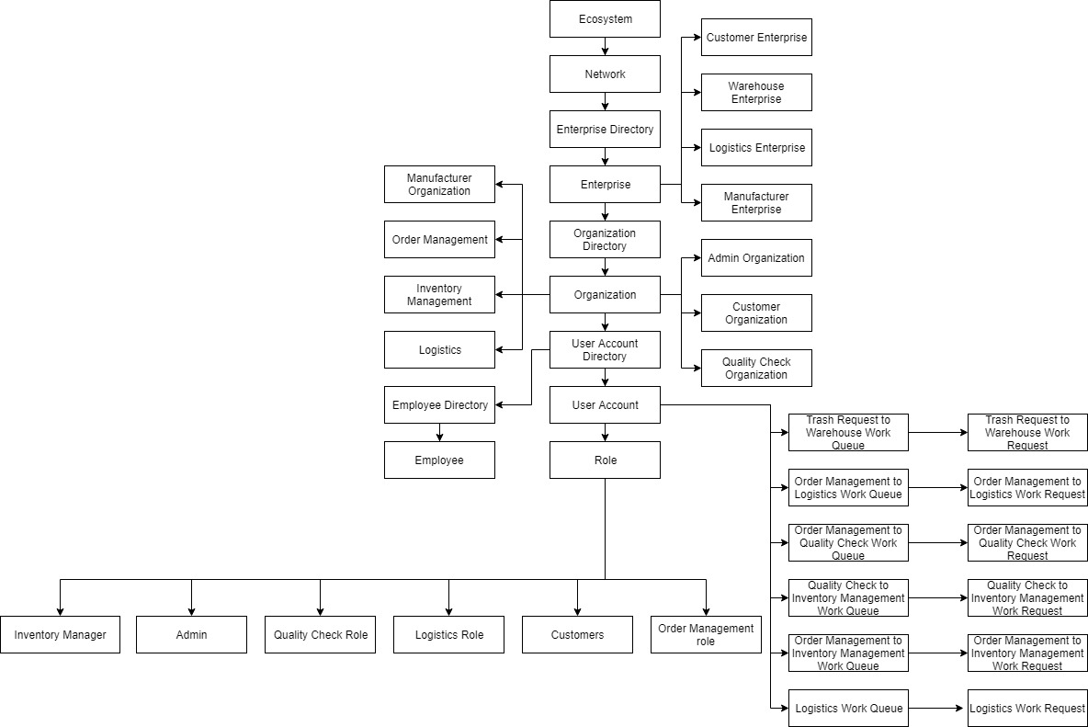
Object Model

Slide 9
Functionalities/Use Cases
System Admin
Adds network, Enterprises and creates enterprise admins
Enterprise Admin
Adds employees and organizations
Customer
Can request for trash pick up and redeem rewards
Order Management
Can process the customers orders, send pick up requests to logistics, check inventory, send the trash to quality check and check analytics
Logistics
Receives the request from Order Management to pick up trash from customers and manufacturers

Slide 10
Inventory Management
Can keep a track of the inventory (Central repository for warehouse)
Manufacturer
Can request the warehouse for the trash pick up

Slide 11
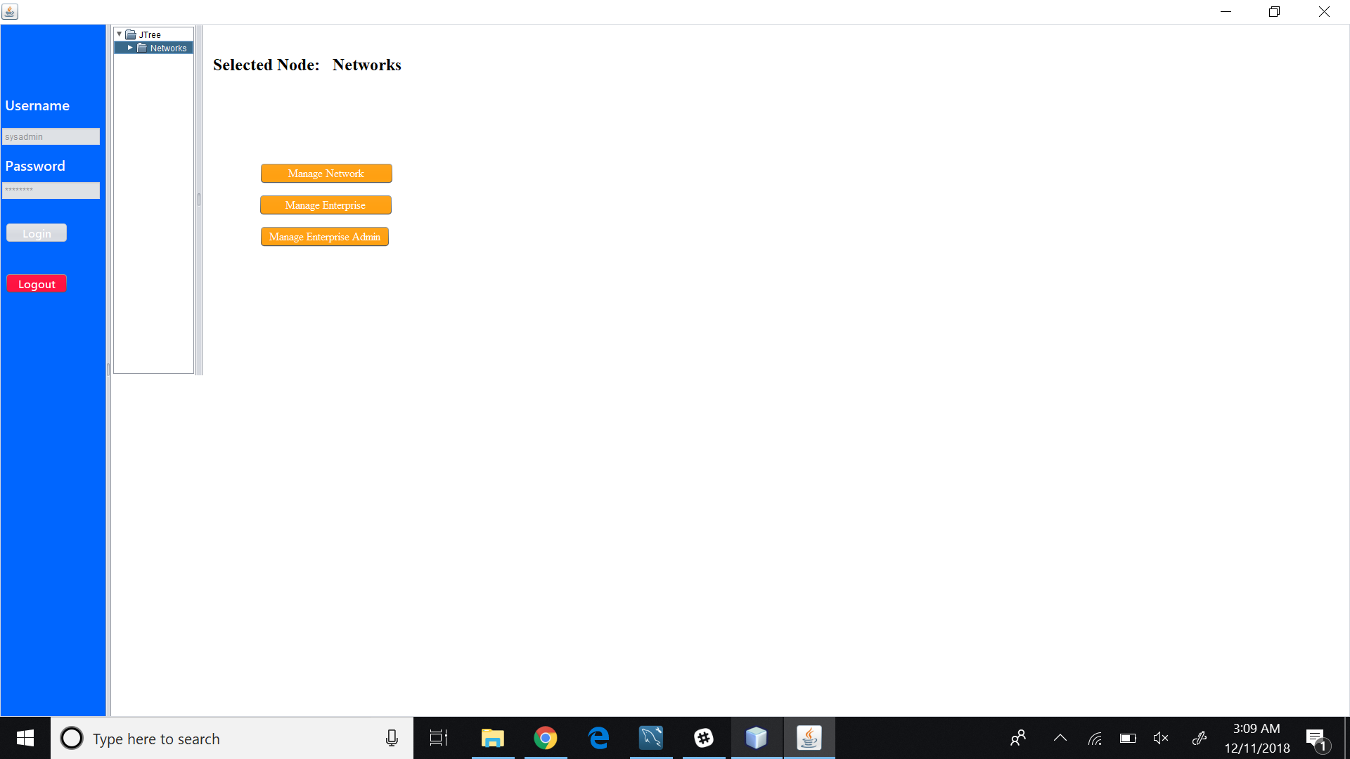
Sample Screenshots

Slide 12
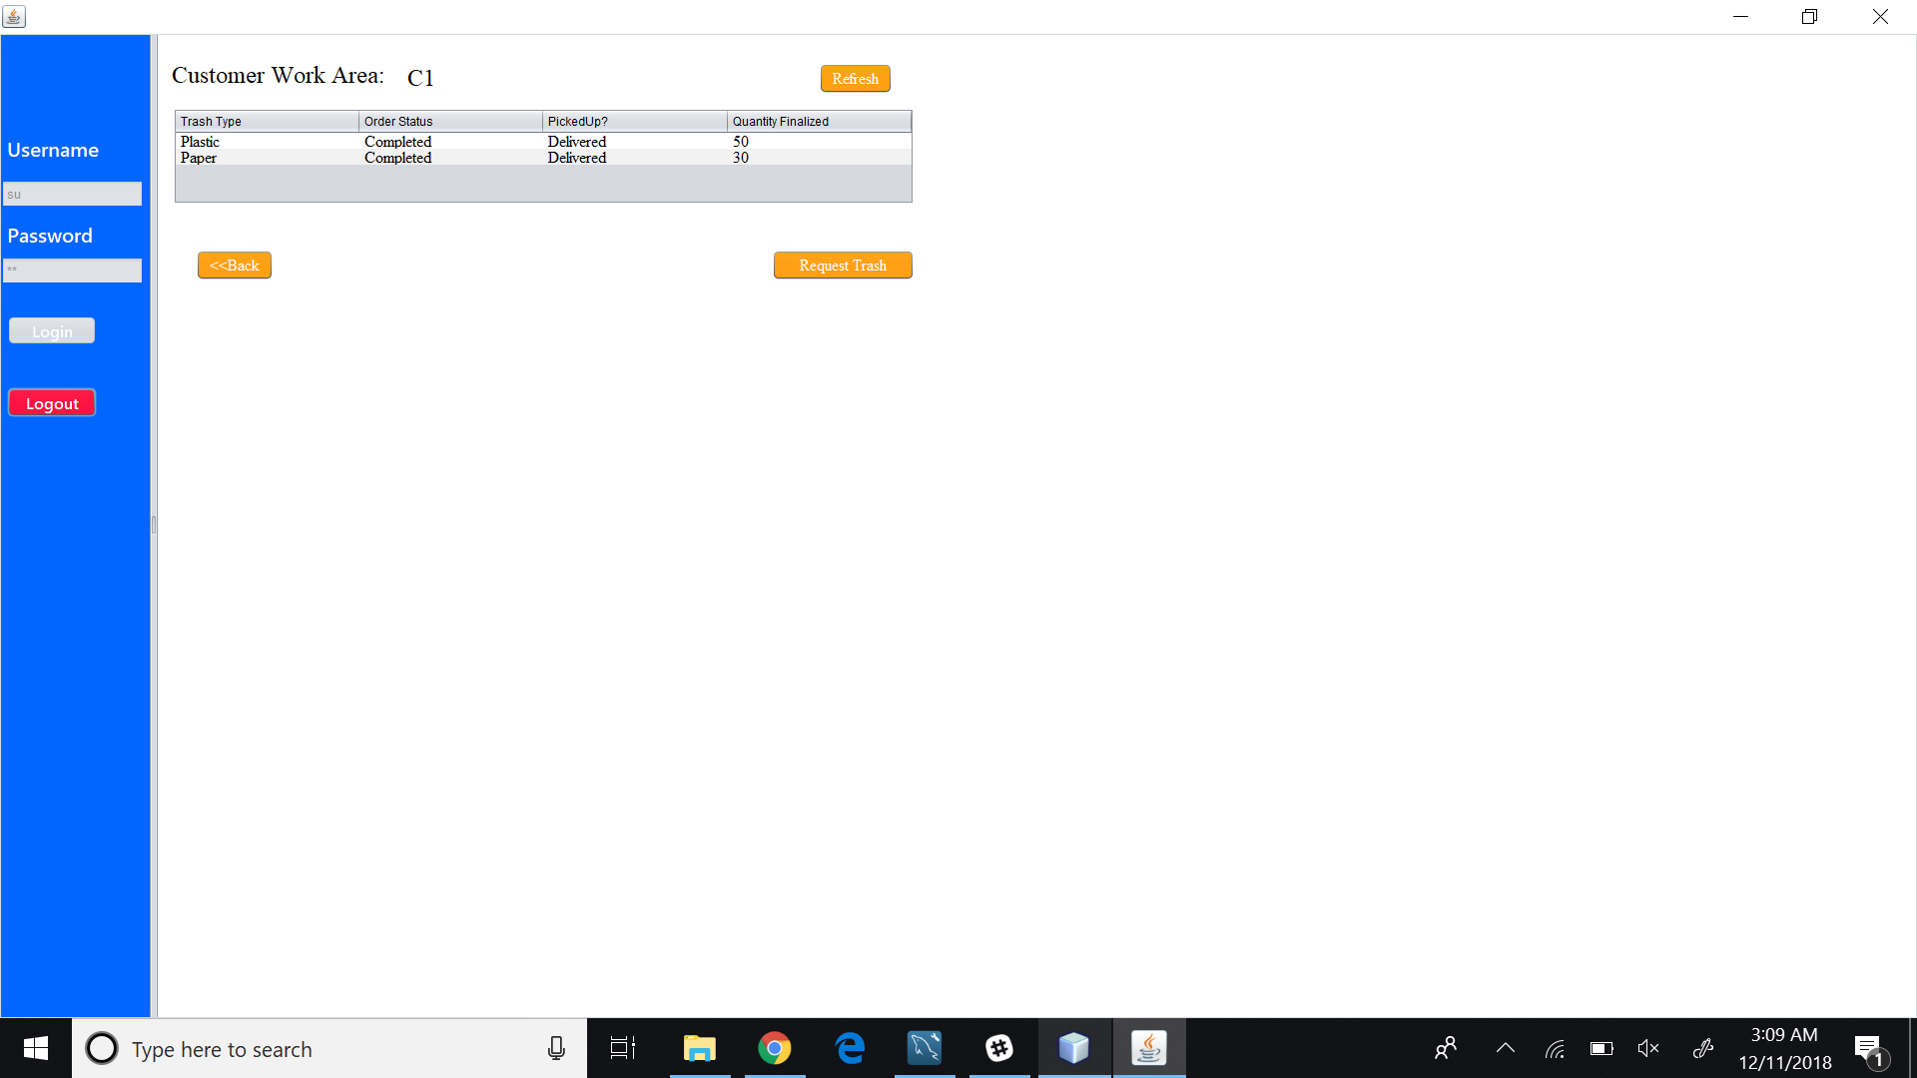

Slide 13
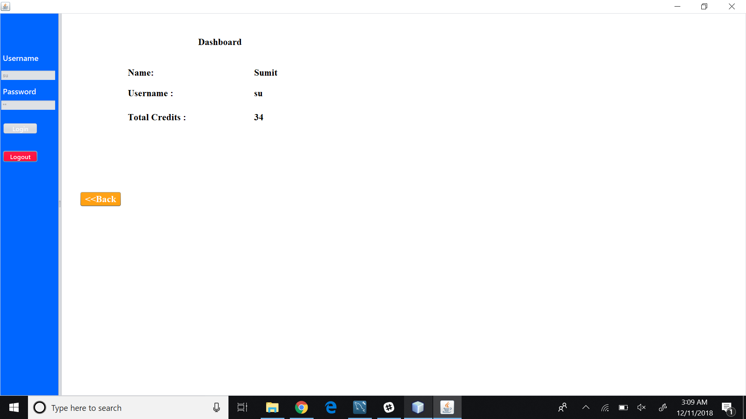

Slide 14
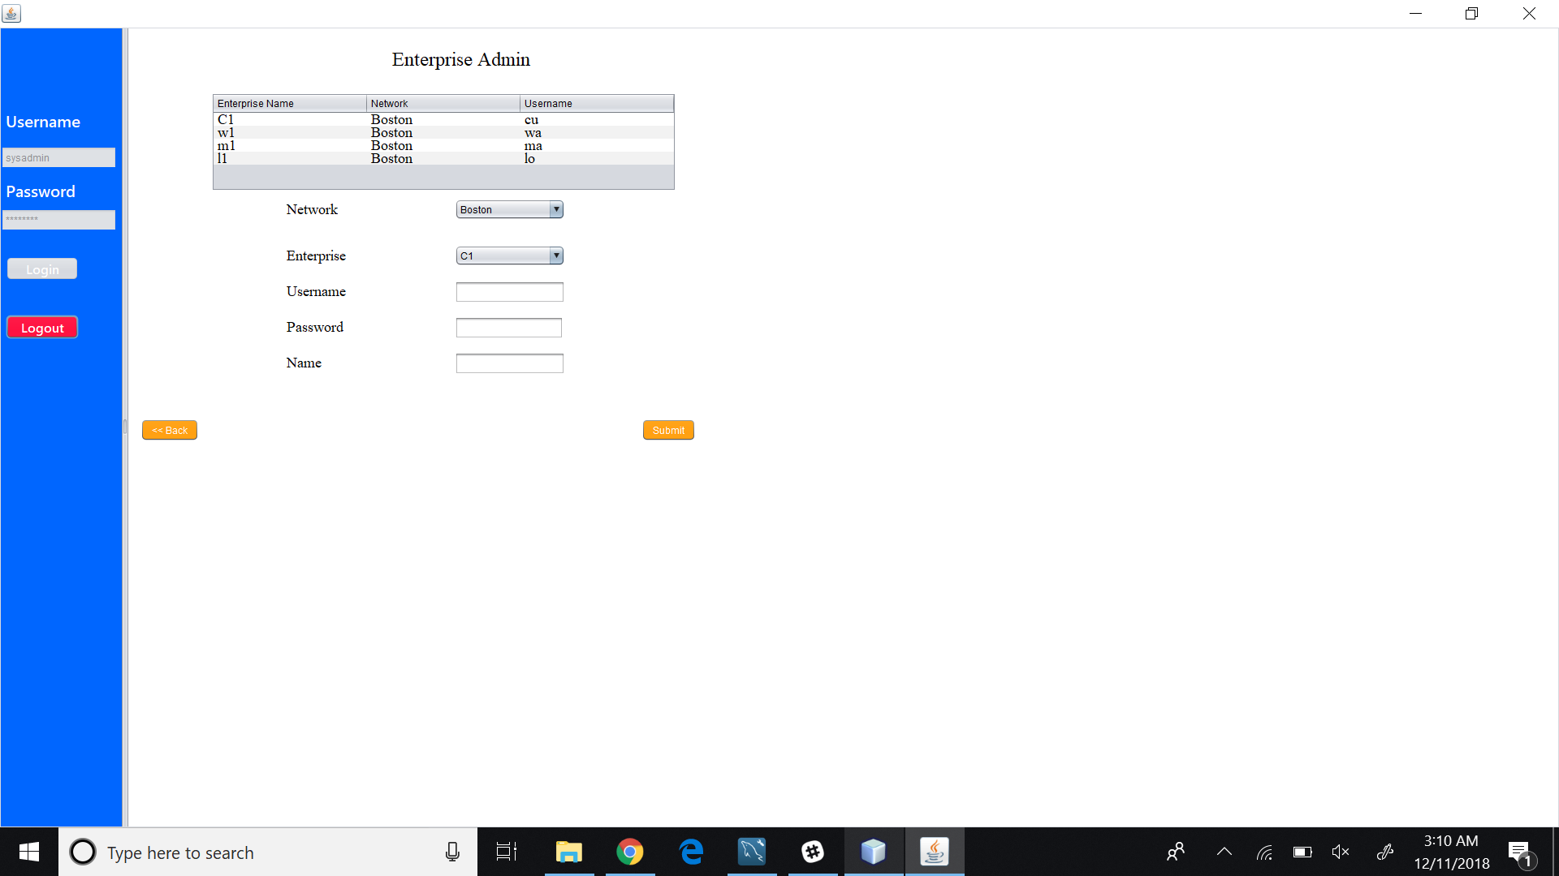

Slide 15
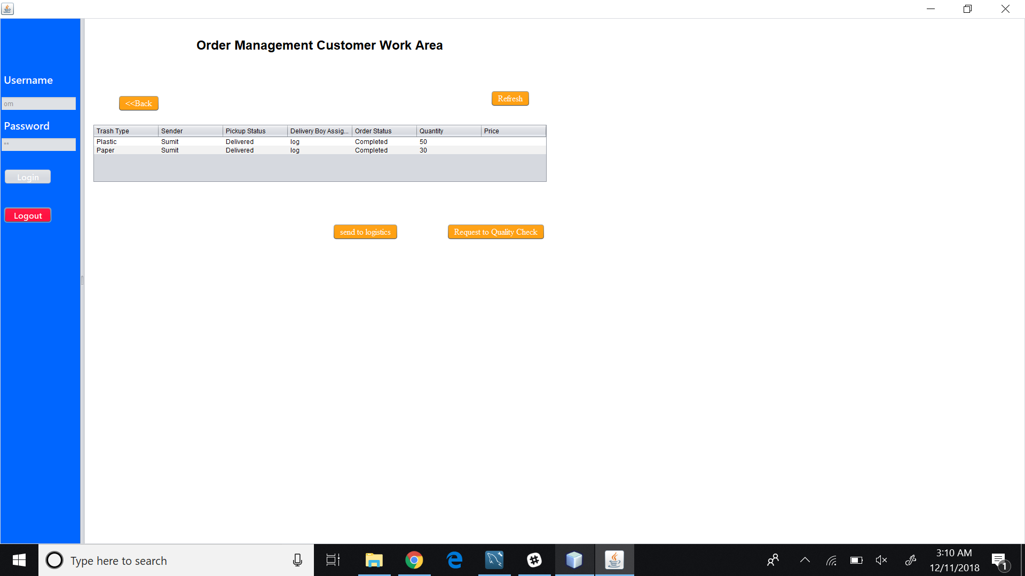

Slide 16
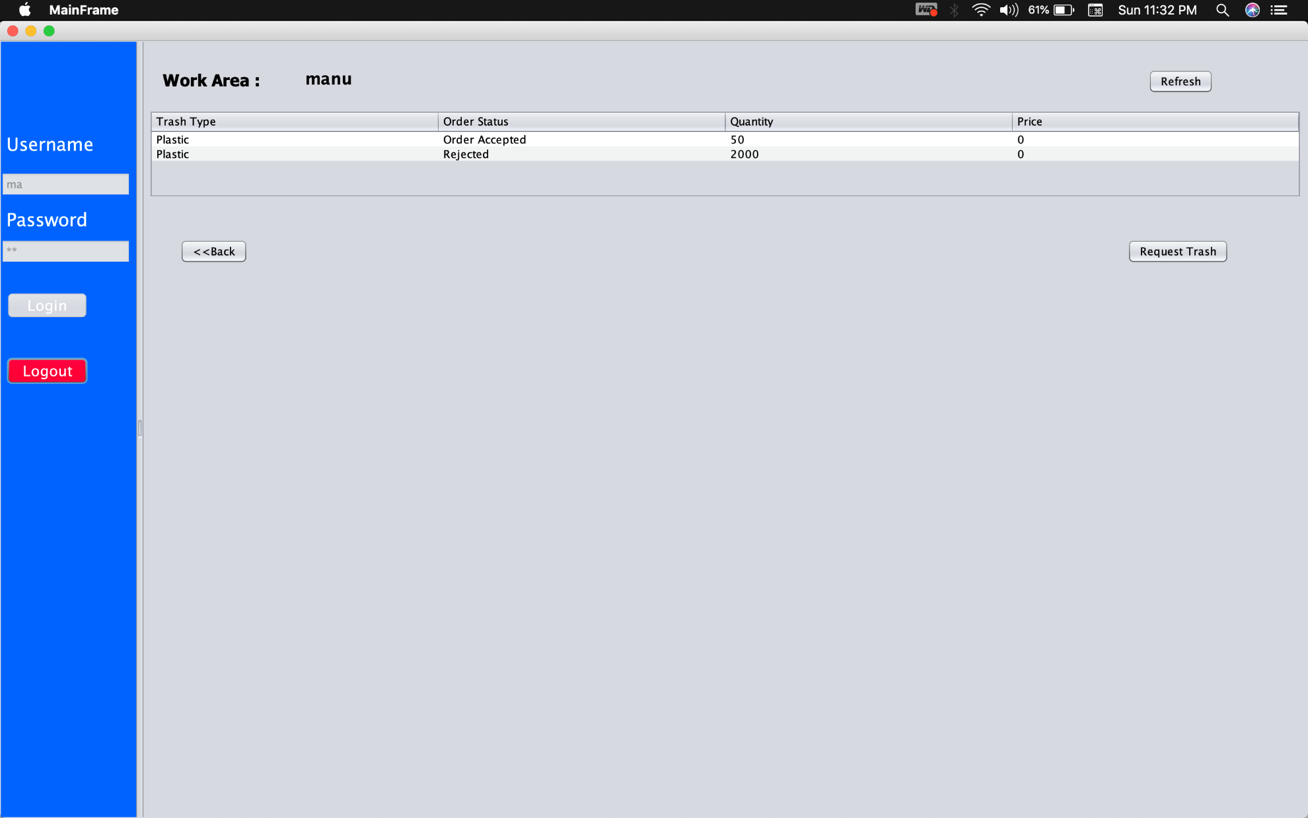

Slide 17
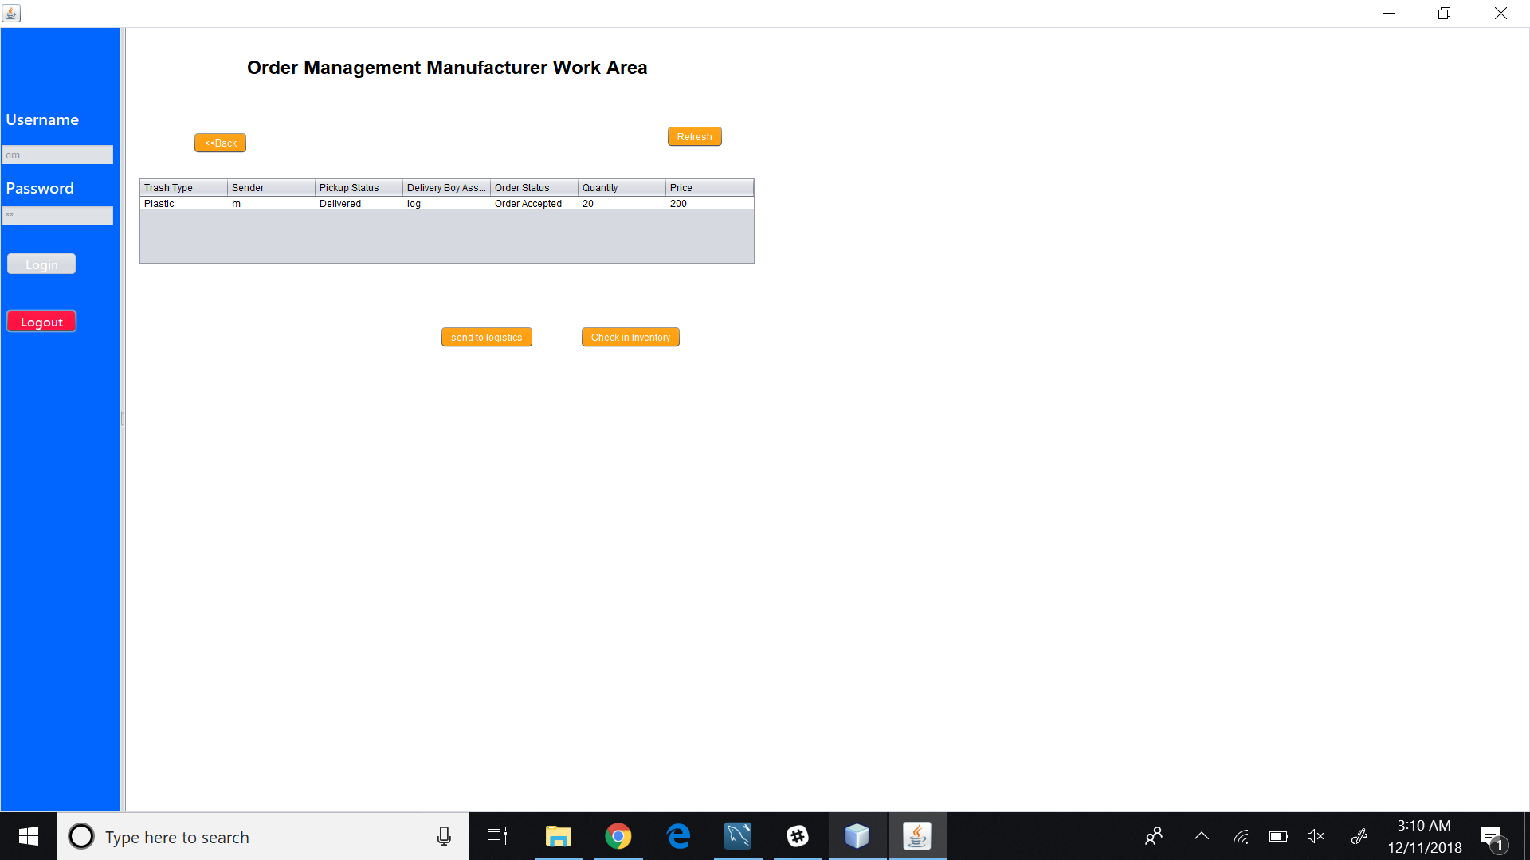

Slide 18
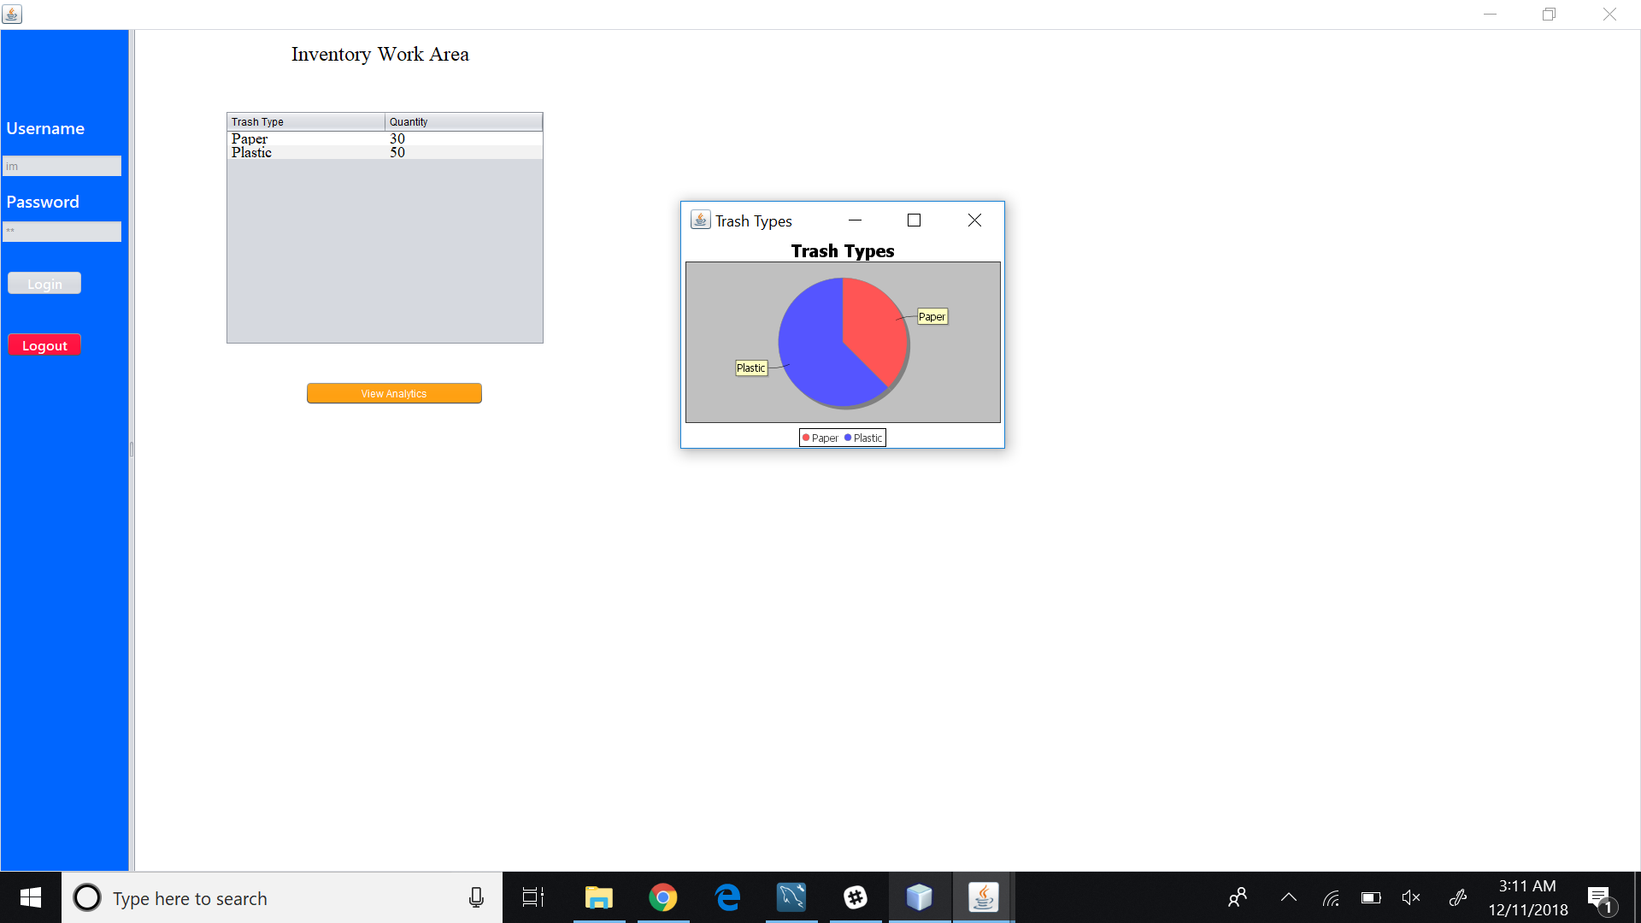

Slide 19
Thank You

